Slide 1
Quality assessment of shotgun metagenomic data

Slide 2
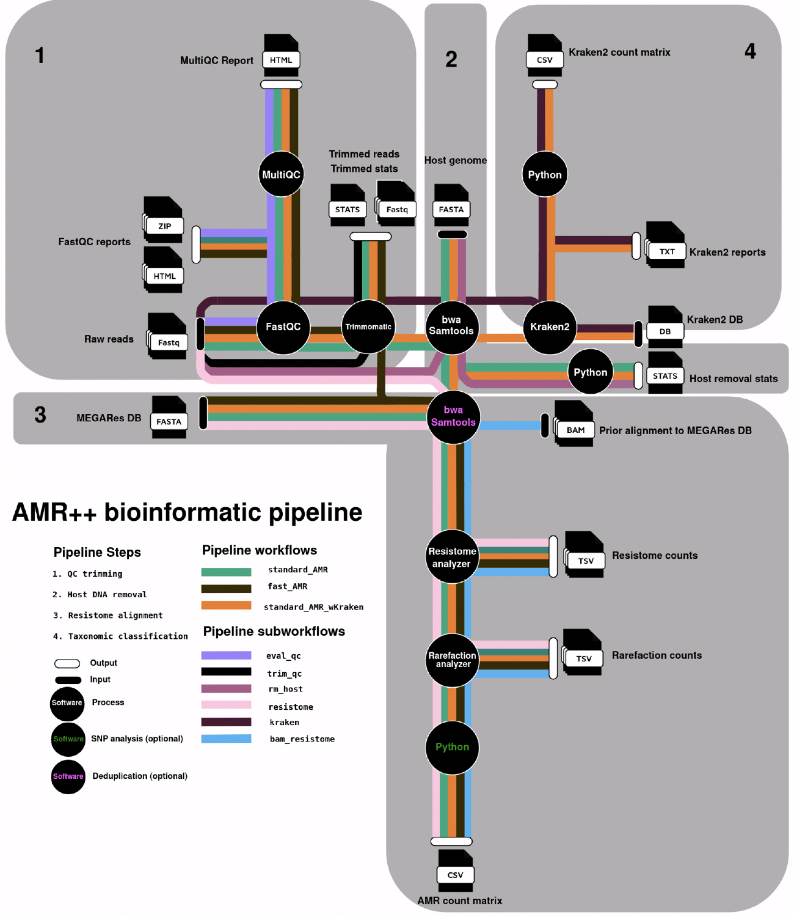
Notes:
- So how do we actually correct for Illumina systemic bias?
- We do this with read trimming, which is done as the first step in the AMR++ pipeline.

Slide 3
Why do we need to do quality assessment?
Notes:
- As Noelle talked about earlier, not all sequences are going to be accurate.
- There could be errors in how the samples were collected or contamination.
- Errors in the library preparation or errors in how the sequencer calls a base if it’s not confident in how it’s reading the flow cell.
- There are also inherent biases associated with the type of sequencing platform you’re using and it’s important for you to understand what these biases are.
- We’re working with Illumina sequencing data but I’ll also describe some of the errors other platforms can give you as well.
- So before you go into your bioinformatic analytic steps, you want to remove this inaccurate data because it can really affect your results.

Slide 4
Why do we need to do quality assessment?
Because sequence data can have errors – both expected and unexpected
Notes:
- As Noelle talked about earlier, not all sequences are going to be accurate.
- There could be errors in how the samples were collected or contamination.
- Errors in the library preparation or errors in how the sequencer calls a base if it’s not confident in how it’s reading the flow cell.
- There are also inherent biases associated with the type of sequencing platform you’re using and it’s important for you to understand what these biases are.
- We’re working with Illumina sequencing data but I’ll also describe some of the errors other platforms can give you as well.
- So before you go into your bioinformatic analytic steps, you want to remove this inaccurate data because it can really affect your results.

Slide 5

Notes:
Do not modify the notes in this section to avoid tampering with the Poll Everywhere activity. More info at polleverywhere.com/support What sequence data errors/problems have you seen or read about?
https://www.polleverywhere.com/free_text_polls/KZjPvYm5R6Xpccb4pvfrG

Slide 6
Sequencing Bias by Platform
Each sequencing method has systematic errors:
Illumina: read quality declines toward end of read (base substitutions)
PacBio: indels (insertion/deletion)
Nanopore: it’s complicated
Need to select the appropriate method for detection (and possible correction) of these errors
AMR++ assumes Illumina sequencing
Some bioinformatic tools do not actually require error-corrected data, but it’s considered best practice to do so anyway
Notes:
- As I just talked about, Illumina has read quality that falls towards the end due to base substitutions.
- If you’re using Life Technologies (previously Ion Torrent), you can get insertions (random runs of a single nucleotide [a bunch of As, Gs]) or deletions.
- And the same for PacBio: insertions and deletions.
- Typically Illumina is considered more accurate; Life Tech. and PacBio are typically considered to have higher error rates.
- It’s very important to select the correct method for correcting those errors.
- AMR++ assumes you’re using Illumina sequencing so the quality control steps are geared towards cleaning up systemic biases in Illumina data.
- If you sequenced on a different platform someone here may be able to customize the QC steps for your data.

Slide 7
Why do we need to do quality assessment?
Because sequence data can have errors – both expected and unexpected
Because sequence data usually contain both technical and biological sequence
Notes:
- As Noelle talked about earlier, not all sequences are going to be accurate.
- There could be errors in how the samples were collected or contamination.
- Errors in the library preparation or errors in how the sequencer calls a base if it’s not confident in how it’s reading the flow cell.
- There are also inherent biases associated with the type of sequencing platform you’re using and it’s important for you to understand what these biases are.
- We’re working with Illumina sequencing data but I’ll also describe some of the errors other platforms can give you as well.
- So before you go into your bioinformatic analytic steps, you want to remove this inaccurate data because it can really affect your results.

Slide 8
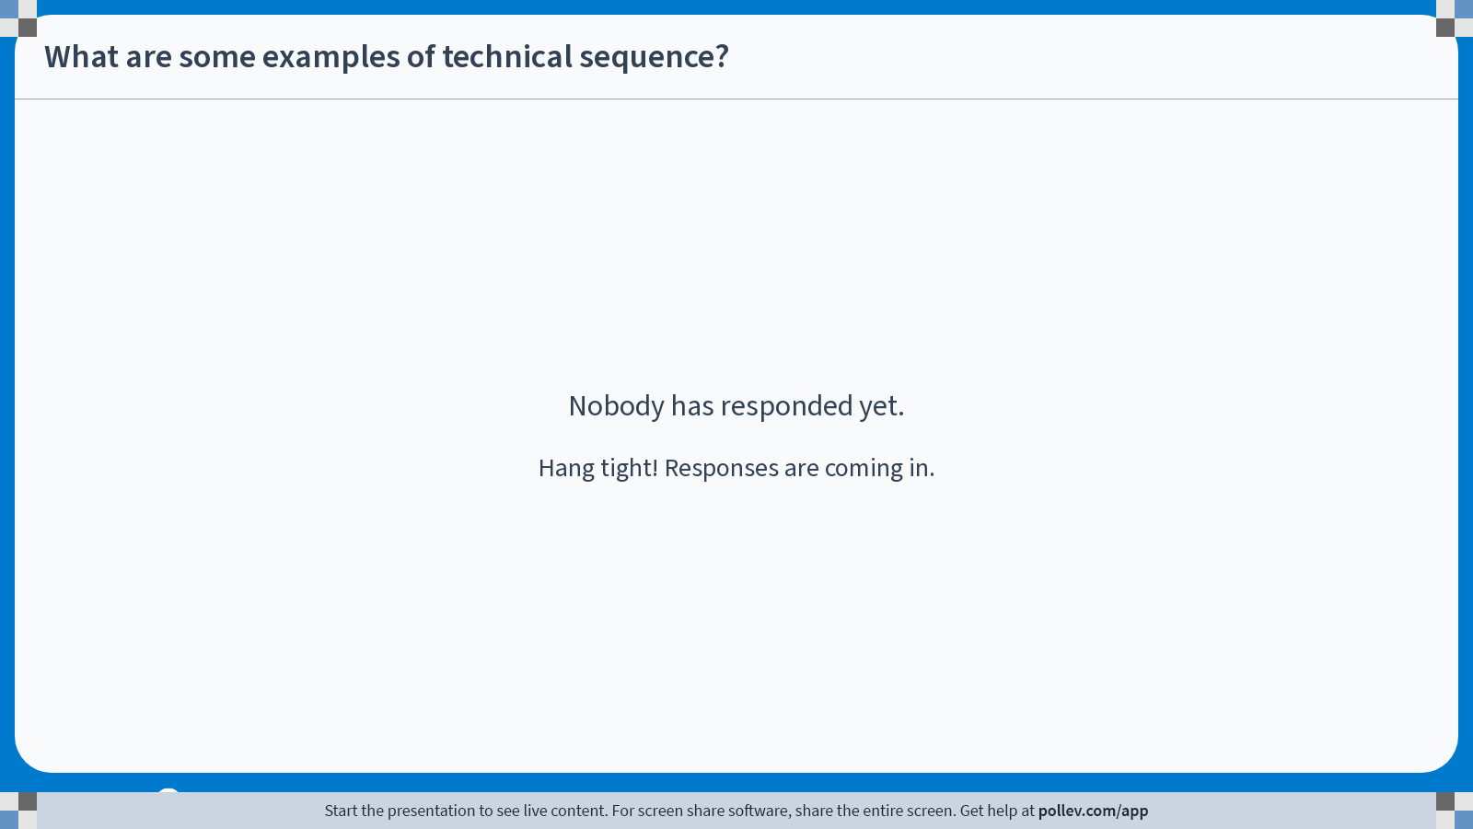
Notes:
Do not modify the notes in this section to avoid tampering with the Poll Everywhere activity. More info at polleverywhere.com/support What are some examples of technical sequence?
https://www.polleverywhere.com/free_text_polls/pDbgce4cetuI2DHDx8aEA

Slide 9
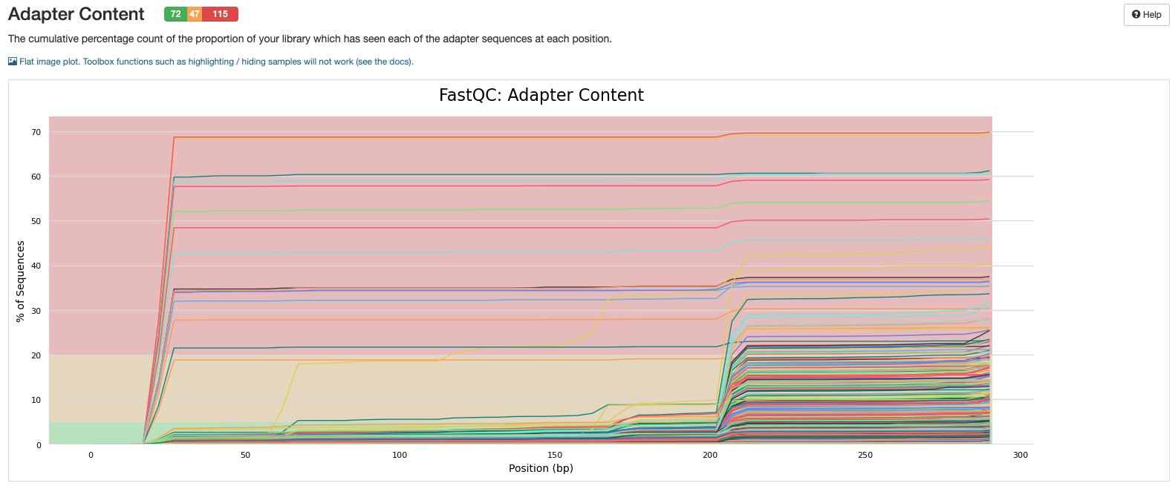
Example of adapter read-through

Slide 10



Sequence Quality Control Steps
Assessment of sequence quality
Trimming of FASTQ sequences
Filtering of off-target reads (next lecture)
Notes:
- You can improve your results significantly if you do the three following basic steps:
Assessing the sequence quality of your sample (which Noelle has already talked about a bit)
Trimming your sequences
Filtering potentially inaccurate sequences, including host-associated reads
- #2 and #3 are both included in the AMR++ pipeline.

Slide 11
Assessment of Sequence Quality
Typically, fastQC and/or multiQC
Notes:
- There are several programs available that are not packaged in AMR++ but that you can download on your own and use.
- A very popular one is FastQC and I’ll show you a visual from that program on the next slide.
- These programs provide quantile information at each position in the read so you can get a good idea of read quality distribution in that sample.
- FastQC give a lot of other really nice information on sequencing quality that we’re not going to go into here but you can find a really nice description of on their website…

Slide 12
Notes:
- So how do we actually correct for Illumina systemic bias?
- We do this with read trimming, which is done as the first step in the AMR++ pipeline.

Slide 13
QC Metric #1: The Phred Score

Slide 14
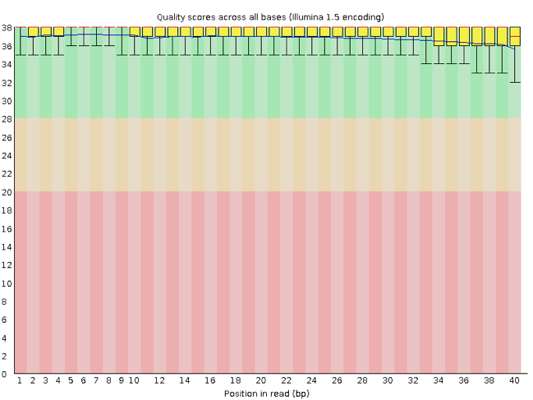
FastQC Output: Good Illumina Data
Phred quality score
Position in read (bp)
Notes:
- Here’s an example of a good read quality distribution from FastQC output.
- On the y-axis we have the Phred quality score and on the x-axis we have position in the read, with 1 being the first base and 40 being the last base in the read.
- You have box and whisker plots showing the distribution of your quality scores for each position in this sample.
You can see here that all of these are above 30, even those in the lower quartile are above 30.
This is a really nice sample.

Slide 15
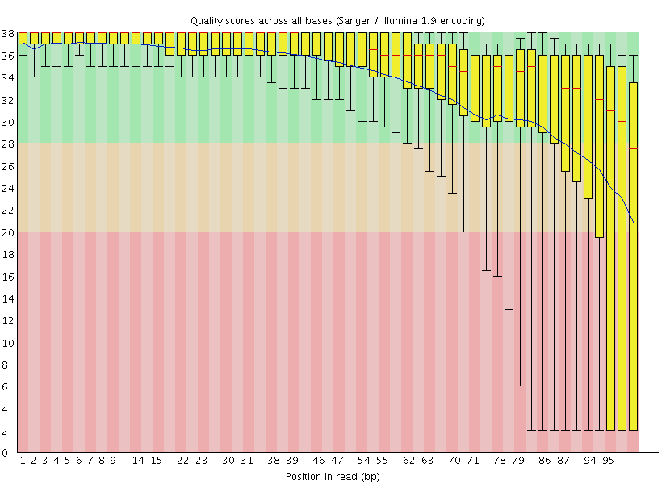
FastQC Output: Bad Illumina Data
Phred quality score
Position in read (bp)
Notes:
- This is an example of a bad read quality distribution.
- You can see that we’re above 30 until about 50 bp into the read and then it drops off substantially at the end of the read.
- This is one of the systemic biases with Illumina sequencing that you’ll get lower quality scores towards the end of the reads.
- If you see this you may want to go back to your sequencing quality metrics and see if the sample has good quality scores.
- Something else to note, the quality of reverse read 2 is typically worse than the quality of forward read, particularly in later cycles.

Slide 16
Let’s look at a multiQC report together

Slide 17
Trimming of FASTQ Sequences
Trimming corrects several error types:
Illumina systematic bias (end of read base substitutions)
Adapter sequences
Missing mate-pairs
Low quality reads
Notes:
- Read trimming can actually correct for more than just systemic bias:
2. We want to remove any adaptor sequences from library preparation that may have accidentally been sequenced.
- These adaptor sequences are not part of your biological data, not part of the microbiome or resistome, and so you want to get rid of them before you continue.
3. If one read does not have a mate pair- for example a forward read doesn’t have a reverse read matched with it, you want to remove them (assuming you’re doing paired-end sequencing).
4. We also want to filter those low-quality reads that we talked about on the previous slides.

Slide 18
Trimming with Trimmomatic
AMR++ utilizes Trimmomatic
Java-based program
Sliding window quality filtering
Includes Illumina adapter screening
Read quality filtering
Downstream tasks can benefit greatly from these QC steps
Classification
Assembly
Alignment
(Bolger et al. 2014)
Notes:
- AMR++ uses the program Trimmomatic to do this FASTQ trimming.
This is a Java-based program
Uses what’s called a sliding window quality filtering algorithm.
- It includes inherent filtering of Illumina adaptors
- And if can handle the read quality filtering as well.
In their paper, Bolger et al 2014, the creators of Trimmomatic, demonstrate that this drastically improves classification, assembly, and alignment, which the pipeline uses later on.

Slide 19
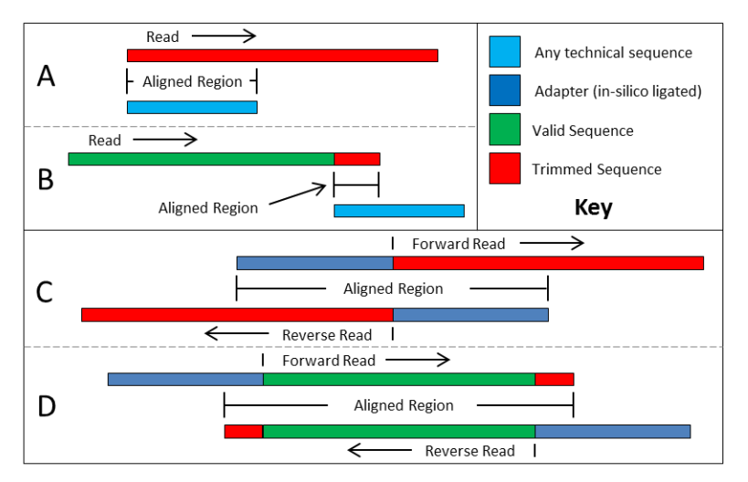
Trimming with Trimmomatic
A
(Modified figure from Trimmomatic manual)
Notes:
- So here is an example from the Trimmomatic manual.
- Box A is kind of the ideal scenario.
- The green region is your biological sequence and you can see by the arrows that there is a forward and reverse reads overlapping that biological sequence.
- And the blue is the adaptors- you don’t want to sequence the adaptors.
- So if Trimmmomatic finds an adaptor it will remove it.
- It also will use information about the read alignments to remove smaller portions of the adaptors, such as the area in red, that aligns with the adaptor from the read mate.

Slide 20
Trimming with Trimmomatic
A
B
(Modified figure from Trimmomatic manual)
Notes:
- Sometimes for whatever reason a read missed the biological sequence entirely, like in box B, see that the only part of these reads that is aligning is the adaptor sequence, it will get rid of this entire read.

Slide 21
Trimming with Trimmomatic
A
B
C
(Modified figure from Trimmomatic manual)
Notes:
- If any other kind of Illumina technical sequence, like a barcode or a blocker represented in light blue, matches to your reads, Trimmomatic will also get rid of that as well- for example this area in red here.
- So this is how Trimmomatic works and it’s really quite an effective program.
- AMR++ will run Trimmomatic for you.
- There are default settings, but they can be changed by you depending on how stringent you would like to be.

Slide 22
These steps are also relevant to 16S data
A brief science story…..

Slide 23
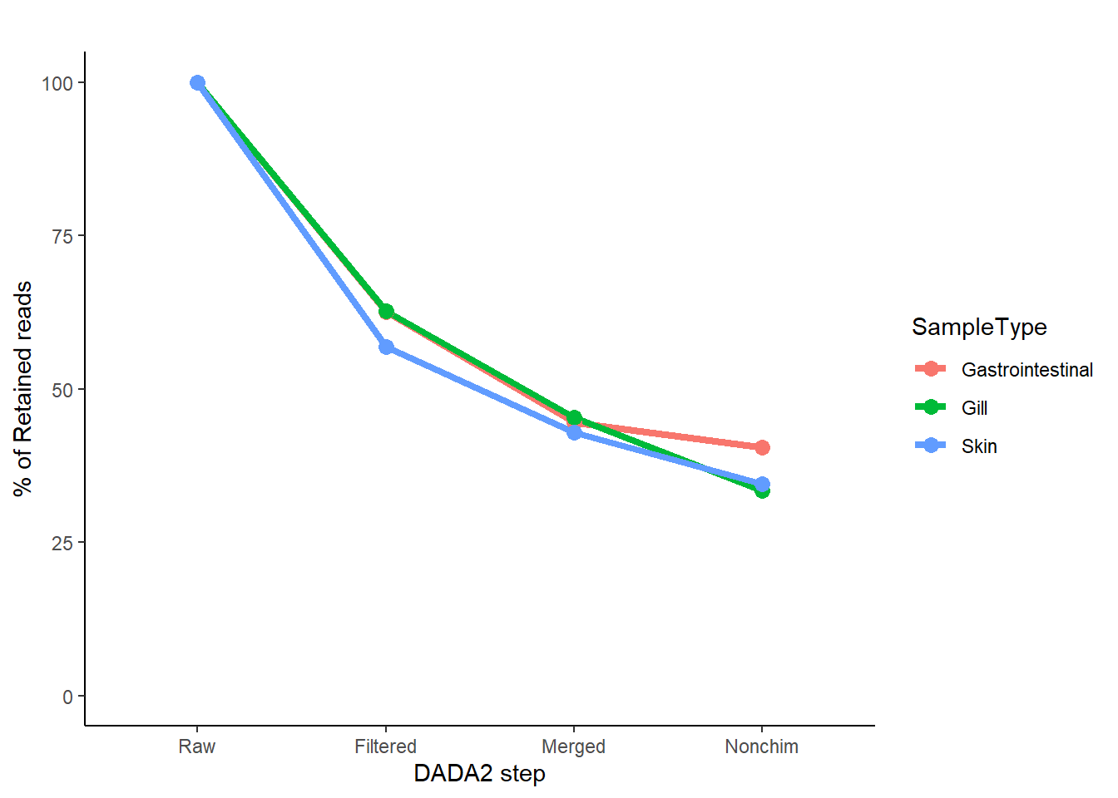
From a recent meta-analysis of salmonid microbiome literature (unpublished):

Slide 24
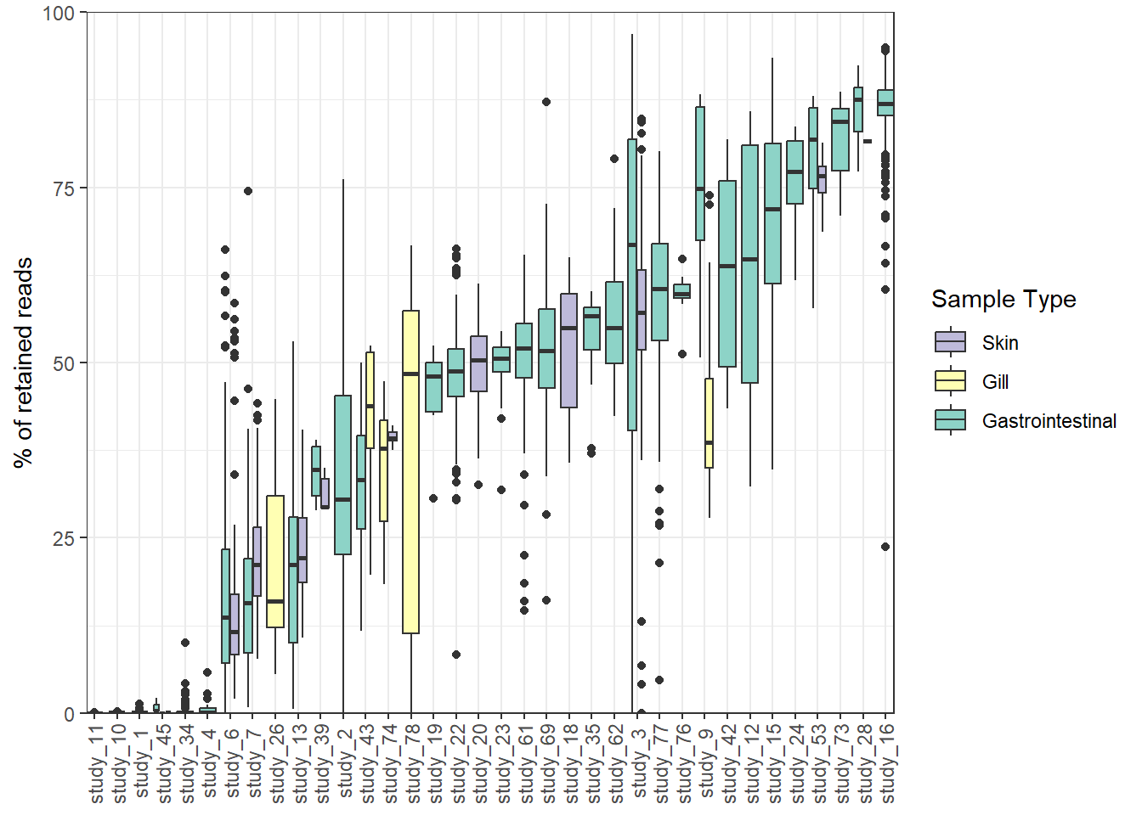
This can be very study-dependent:

Slide 25
Notes:
- So how do we actually correct for Illumina systemic bias?
- We do this with read trimming, which is done as the first step in the AMR++ pipeline.

Slide 26
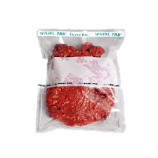
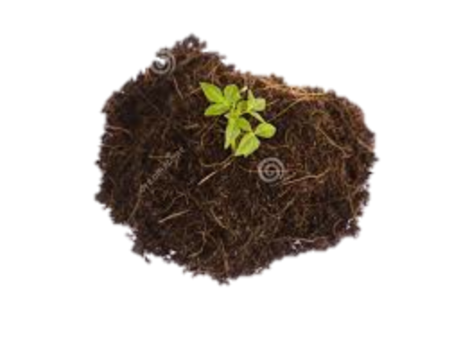

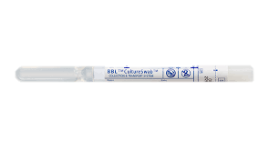

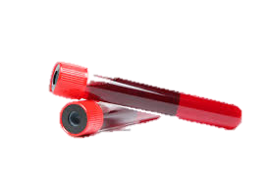

Filtering of Off-Target Reads
Samples collected from hosts contain host DNA
Known contaminants might be present due to library preparation techniques
Notes:
The next step are those reads that have passed quality control by Trimmomatic are going to go through filtering of host contamination.
As Noelle mentioned before, obviously samples collected from a host will contain host DNA.
The type of sample you’re collecting will to some extent determine how much host DNA you have in a sample.
For example, host DNA in fecal samples is relatively low compared to the amount of host DNA in, for example, a swab.
Known contaminants may also be present due to library preparation techniques.

Slide 27
Filtering of Off-Target Reads
Filtering host DNA removes the chance of false positive classification
AMR++ filtering:
Single filtering genome
Multiple filtering genome
Trimmed Reads
Host Genome
Notes:
Filtering these contaminants removes false positive classification later on.
To do this contamination filtering step, AMR++ aligns our trimmed reads to a host genome file that you provide as input.
So if you’re working on human samples, you can provide a human genome, bovine samples, the bovine genome.
And if you’re working on samples that potentially have multiple species contaminants in it, you that you can concatenate the files together and that will give you multiple genome filtering option.
So any reads that align to the host genome are removed from the data set.

Slide 28
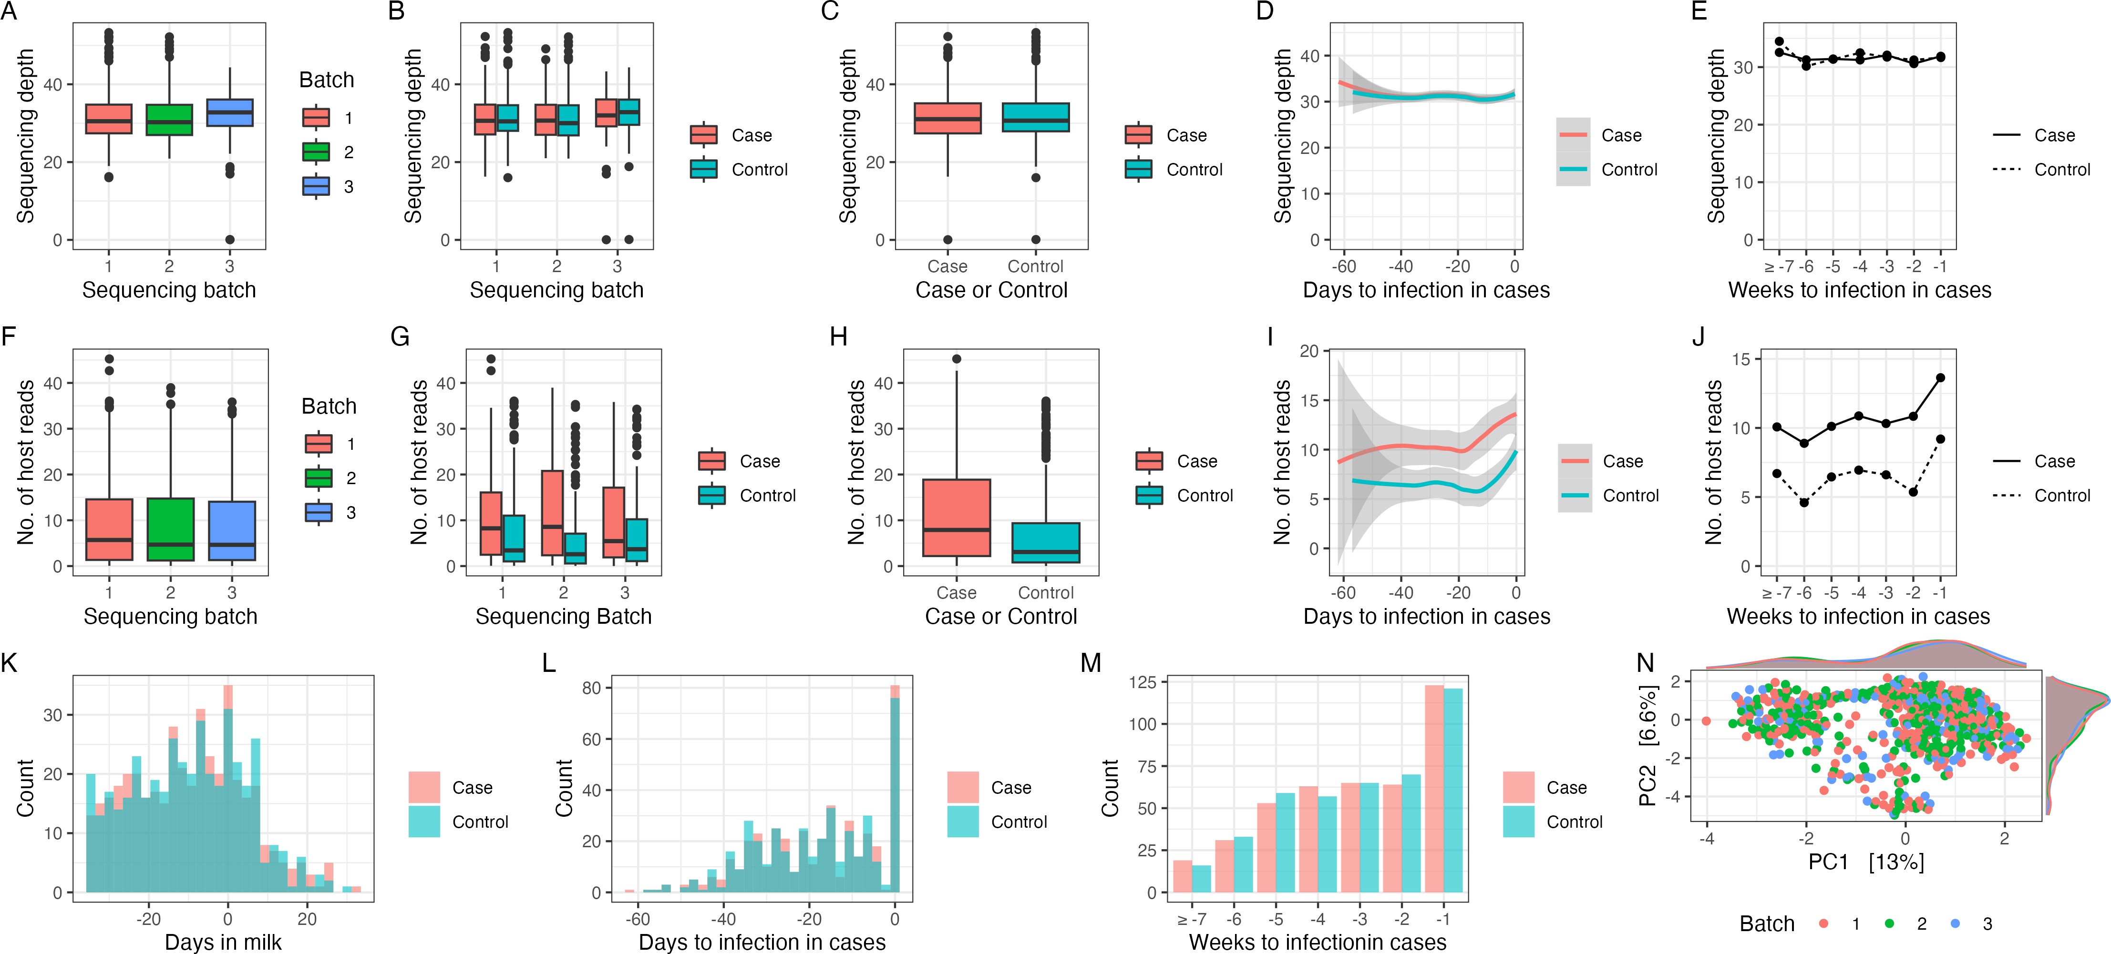
This can uncover some interesting findings!
Dean CJ, PeñaMosca F, Ray T, Wehri TJ, Sharpe K, Antunes AM, Doster E, Fernandes L, Calles VF, Bauman C, Godden S, Heins B, Pinedo P, Machado VS, Caixeta LS, Noyes NR. 2024. Exploring associations between the teat apex metagenome and Staphylococcus aureus intramammary infections in primiparous cows under organic directives. Appl Environ Microbiol 90:e02234-23.https://doi.org/10.1128/aem.02234-23

Slide 29
This can uncover some interesting findings!
Dean CJ, PeñaMosca F, Ray T, Wehri TJ, Sharpe K, Antunes AM, Doster E, Fernandes L, Calles VF, Bauman C, Godden S, Heins B, Pinedo P, Machado VS, Caixeta LS, Noyes NR. 2024. Exploring associations between the teat apex metagenome and Staphylococcus aureus intramammary infections in primiparous cows under organic directives. Appl Environ Microbiol 90:e02234-23.https://doi.org/10.1128/aem.02234-23

Slide 30

Notes:
Do not modify the notes in this section to avoid tampering with the Poll Everywhere activity. More info at polleverywhere.com/support What are some other methods for reducing host?
https://www.polleverywhere.com/free_text_polls/j1siDziZB3IhBV8sm2Yw8

Slide 31
Notes:
- So how do we actually correct for Illumina systemic bias?
- We do this with read trimming, which is done as the first step in the AMR++ pipeline.

